Slide 1
Classification of Image-time series based on Spatio-temporal representations

Slide 2
Intro
A Satellite Image Time Series (SITS) is a set of satellite images taken from the same scene at different times.
Satellite observations offer opportunities for understanding how Earth is changing, for determining the causes of these changes, and for predicting future changes.
Sensors with high spatial and temporal resolutions make the observation of precise spatio-temporal structures in dynamic scenes more accessible. Temporal components integrated with spectral and spatial dimensions allows the identification of complex patterns concerning applications connected with environmental monitoring and analysis of land-cover dynamics.

Slide 3
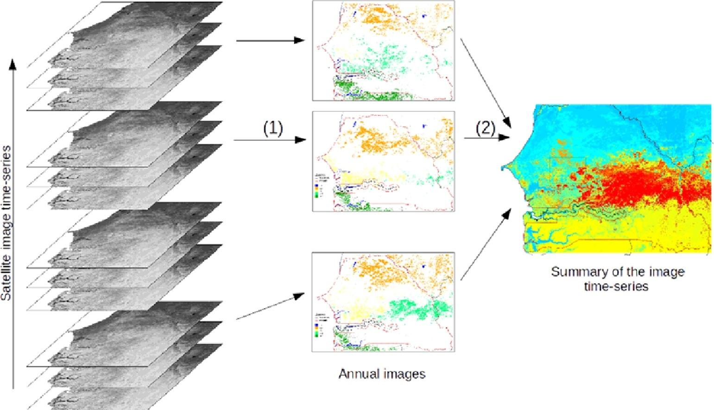
Intro

Slide 4
Intro
The multiplicity of sensors, coupled with the society appetites(e.g., industrial, scientific, leisure) in image content, leads to the production of mass of visual data.
In some cases, this visual data are 3𝐷 (2𝐷+𝑡 in practice) data when the sensors produce images of a scene at different times.
The produced 2𝐷+𝑡 data carry rich spatial and temporal information that must be taken into account to understand particular phenomena not being observable from a single image of the sequence. Whether considering a stack of images or a video, we will denote these 2𝐷+𝑡 data as Image Time Series (ITS).

Slide 5
Intro
An ITS is basically a set of images of the same scene, ordered chronologically.
It can be encoded as a data-cube, two spatial and one temporal dimensions. The acquisition of an ITS can be done with one or multiple sensors to obtain a larger data series with a high temporal frequency.
The original 2𝐷 spatial dimension of the ITS is embedded in a 1𝐷 structure trying to preserve the pixels spatial configuration. Such 1𝐷 spatial structure is coupled with the 1𝐷 original temporal domain of the ITS in a 2𝐷(planar) spatio-temporal representation, leading to a novel way to structure the ITS, making easier calculus and interpretation.

Slide 6
Neural Network and CNN
This new representation is used to feed a Convolutional Neural Network (CNN) to learn spatio-temporal features, resulting ultimately to classification decisions.
A convolutional neural network (CNN) is a type of artificial neural network used in image recognition and processing that is specifically designed to process pixel data.
A neural network is a system of hardware and/or software patterned after the operation of neurons in the human brain. Traditional neural networks are not ideal for image processing and must be fed images in reduced-resolution pieces. CNN have their “neurons” arranged more like those of the frontal lobe, the area responsible for processing visual stimuli in humans and other animals. The layers of neurons are arranged in such a way as to cover the entire visual field avoiding the piecemeal image processing problem of traditional neural networks.

Slide 7
CNN
A CNN uses a system much like a multilayer perceptron that has been designed for reduced processing requirements. The layers of a CNN consist of an input layer, an output layer and a hidden layer that includes multiple convolutional layers, pooling layers, fully connected layers and normalization layers. The removal of limitations and increase in efficiency for image processing results in a system that is far more effective, simpler to trains limited for image processing and natural language processing.

Slide 8
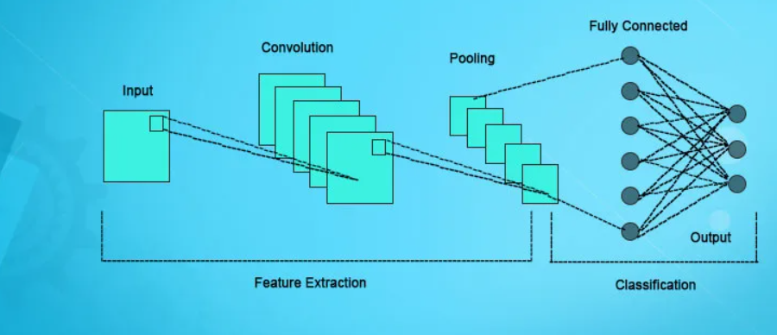
CNN

Slide 9
DTW
The classification task is then applied in this new space (‘‘hand-crafted’’ features from the temporal pixels) where classical approaches rely on similarity and on a training set. Similarity can be computed by different metrics such as an Euclidean distance or a Dynamic Time Wrapping measure.
Dynamic Time Warping is used to compare the similarity or calculate the distance between two arrays or time series with different length.
In time series analysis, dynamic time warping (DTW) is one of the algorithms for measuring similarity between two temporal sequences, which may vary in speed. DTW has been applied to temporal sequences of video, audio, and graphics data — indeed, any data that can be turned into a linear sequence can be analysed with DTW.

Slide 10
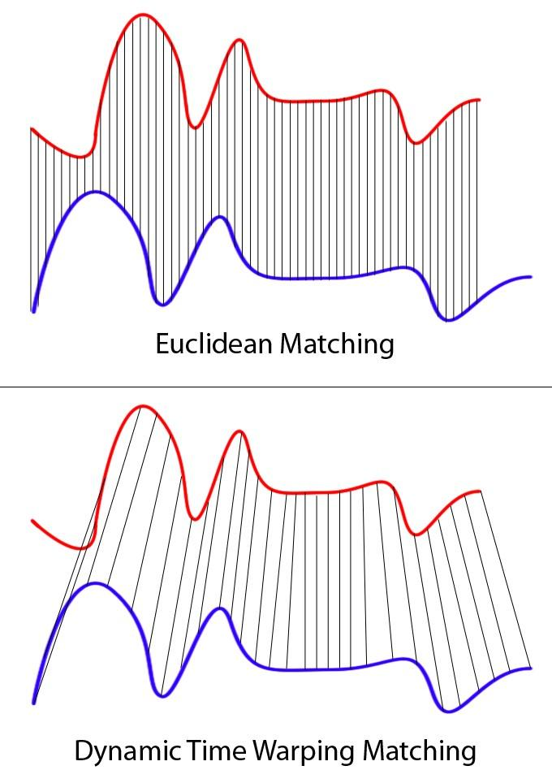
DTW
Clearly these two series follow the same pattern, but the blue curve is longer than the red. If we apply the one-to-one match, shown in the top, the mapping is not perfectly synced up and the tail of the blue curve is being left out.
DTW overcomes the issue by developing a one-to-many match so that the troughs and peaks with the same pattern are perfectly matched, and there is no left out for both curves(shown in the bottom top).

Slide 11
DNN vs CNN
A deep neural network (DNN) is an artificial neural network (ANN) with multiple layers between the input and output layers. There are different types of neural networks but they always consist of the same components: neurons, synapses, weights, biases, and functions
DNN-based approaches offer promising results, they consider (temporal) pixels independently, and generally neglect the image spatial dimensions. However, in certain applications, it is crucial to also consider the spatial aspect of the 2𝐷+𝑡data to discriminate accurately complex classes.
DNN-based approaches have been considered for learning spatio-temporal features.
Authors consider the spatial and the temporal domains separately, training two models, one on each domain, with an aggregation at the decision level.

Slide 12
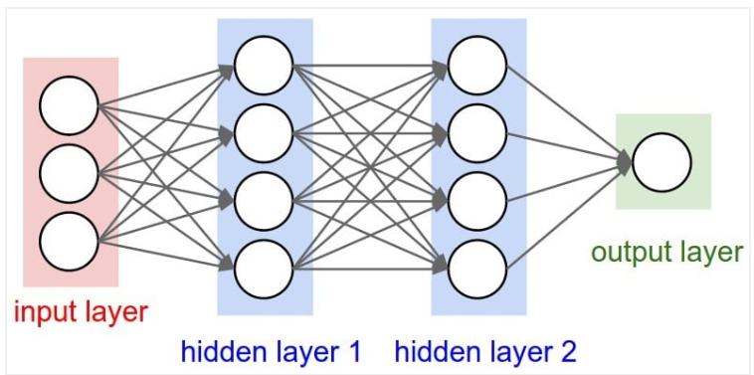
DNN vs CNN
Spatio-temporal features denote features that are computed by involving simultaneously the spatial and the temporal domains of an ITS.
Generally, CNN models are trained and are more active on some parts of images or signals, according to the input. CNN are known as black boxes, due to their lack of interpretability. Indeed, millions of parameters are learned, in particular with large architectures dedicated to 2𝐷+𝑡 or 3𝐷 data analysis.
DNN

Slide 13
Conclusion Till now
In this article, we focus on spatio-temporal features learning using DNN for ITS classification. As discussed in the previous sub-sections, a lot of studies consider only temporal aspect. Considering an ITS is a bag of independent pixel time series, the studies benefit from large sets of samples for supervised learning procedures. On the opposite, complex 3𝐷 CNN methods learn (native) spatio-temporal features but such approaches need a huge database to fix all the parameters and they can lead to solutions difficult to interpret. In our case, we want to benefit from the advantages of both approaches: a large number of training entities for learning and both spatial and temporal information from the original 2𝐷+𝑡 data-cube.

Slide 14
Conclusion Till now
To this end, we propose an ITS classification method based on novel spatio-temporal representations embedding both temporal and spatial information in a 2𝐷 image structure. Such representations allow a classical 2𝐷 CNN to learn 2𝐷 filter weights extracting (native) spatio-temporal features for the ITS classification.
We also propose a novel post-hoc attention mechanism, providing a semantic map, whose originality is to embed attention information in the original ITS 2𝐷+𝑡 space to better understand the CNN decision.

Slide 15
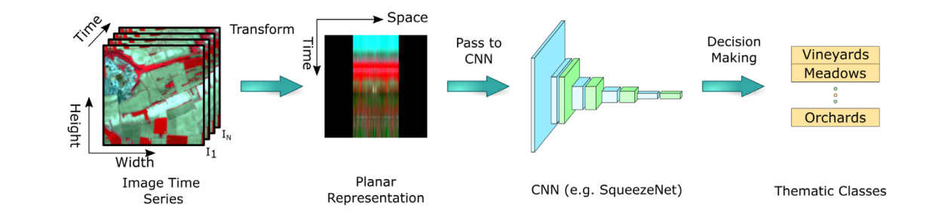
Deep-Star
The core of Deep-STaR is based on the concept of spatio-temporal planar representations. Rather than the original ITS 2𝐷+𝑡 space, we investigate novel 2𝐷 planar representations containing both temporal and spatial information.

Slide 16
Deep-Star
The original 2𝐷 spatial dimension of the ITS is transformed to a 1𝐷 space using different strategies (which can operate at local or global level) trying to preserve the spatial configuration by partially maintaining the neighborhood of the pixels.
This novel 1𝐷 spatial dimension is combined with the original 1𝐷 temporal dimension of the ITS, leading to a 2𝐷 spatio-temporal representation.
This new kind of representation feeds a classical 2𝐷 Convolutional Neural Network (CNN) which learns spatio-temporal features with 2𝐷 convolutions, leading ultimately to classification decision.

Slide 17
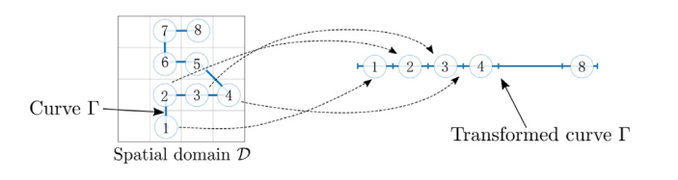
Math
Let us consider a curve 𝛤 in the spatial image domain. We note the curve pixels 𝑃𝑗; they are indexed by their curvilinear abscissa initiated at one of the curve extremity. Then, 𝛤 is represented by the tuple(𝑃1,...,𝑃𝐿), where 𝐿 is the length of the 1𝐷 structure. At this stage, the curve 𝛤embedded in the 2𝐷 space is such, naturally represented in a 1𝐷 structure, i.e., a string of pixels.

Slide 18

Math
The next step is to handle 2𝐷+𝑡 data. The curve 𝛤 defined in the image support has occurrences in all the 𝑁 images of the ITS. Then, the 𝑁 tuples 𝑃= {(𝑃𝑖1,...,𝑃𝑖𝐿)} 𝑁𝑖=1(one tuple per date) are stacked as rows in a 2𝐷 array, interpreted as a new image; such image is called a Spatio-Temporal Representation (STR). The STR size is 𝑁×𝐿. 𝑁, the height refers to the temporal aspect (the number of images in the ITS), 𝐿 the width refers to the spatial aspect (the curve pixel index). Finally, the new 2𝐷 image represents a planar representation of the 2𝐷+𝑡 ITS.

Slide 19
Curves carrying significant spatial information
Random Walk segments (RW):The goal is to pass from single pixels to segments. Here, we propose to build curve segments by a Random Walk (RW) process. RW is a mathematical model to build a path from random iterative steps with Markovian properties. The RW segment with length 𝐿 is noted 𝑅𝑊(𝐿).
The first point of the curve is initialized randomly. 8 directions are possible for choosing next point except if a pixel is next to the region border. Photo presents some examples of 𝑅𝑊(𝐿) with different 𝐿 values and how pixel time series can be enriched with spatial information.

Slide 20
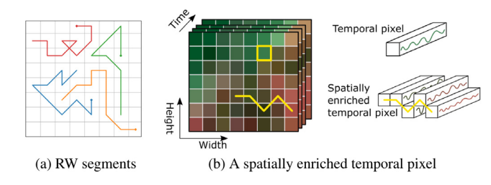
Random Walk segments and enrichment of pixel time series with spatial information

Slide 21
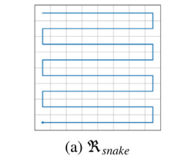
Space filling curves
Snake curve(ℜ𝑠𝑛𝑎𝑘𝑒): this curve scans the plane lines, as a snake. To preserve the spatial relationship, lines are linked, the heads of even lines are linked with ends of odd ones ,and vice versa.

Slide 22
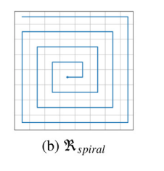
Space filling curves
Spiral curve(ℜ𝑠𝑝𝑖𝑟𝑎𝑙): this curve is based on Archimedean spiral that fills the 2𝐷 square plane. The square center is the curve first point. Then, the curve revolves around.

Slide 23
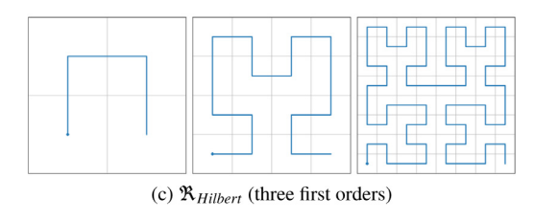
Space filling curves
Hilbert curve(ℜ𝐻𝑖𝑙𝑏𝑒𝑟𝑡): this curve is a fractal space-filling curve. The construction of the curve is based on a recurrent process applied on a square domain. The domain is divided into four equal squares. The four small squares are linked in such away that ‘‘two parts with a common edge have two consecutive indexes’’. This rule is applied recursively on squares with power of 2 as width.

